Slide 1
Online Ordering System for Styled by Nice HOME
GROUP 6
Project Manager / QA Tester - Franz Matthew Salomon
Web Developer - Tricia Mae Domanog
UI/UX Developer - Angelica Cortez
Requirement Analyst - Yves Mabelin

Slide 2
PROBLEM STATEMENT
The orders/transaction via DM in Instagram and Facebook is difficult. Considering that the business is growing, the owner will have difficulties in managing the client’s transaction and inquiries.

Slide 3
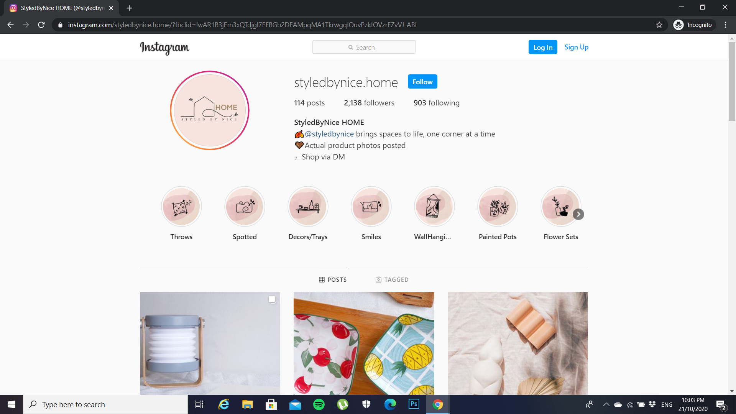
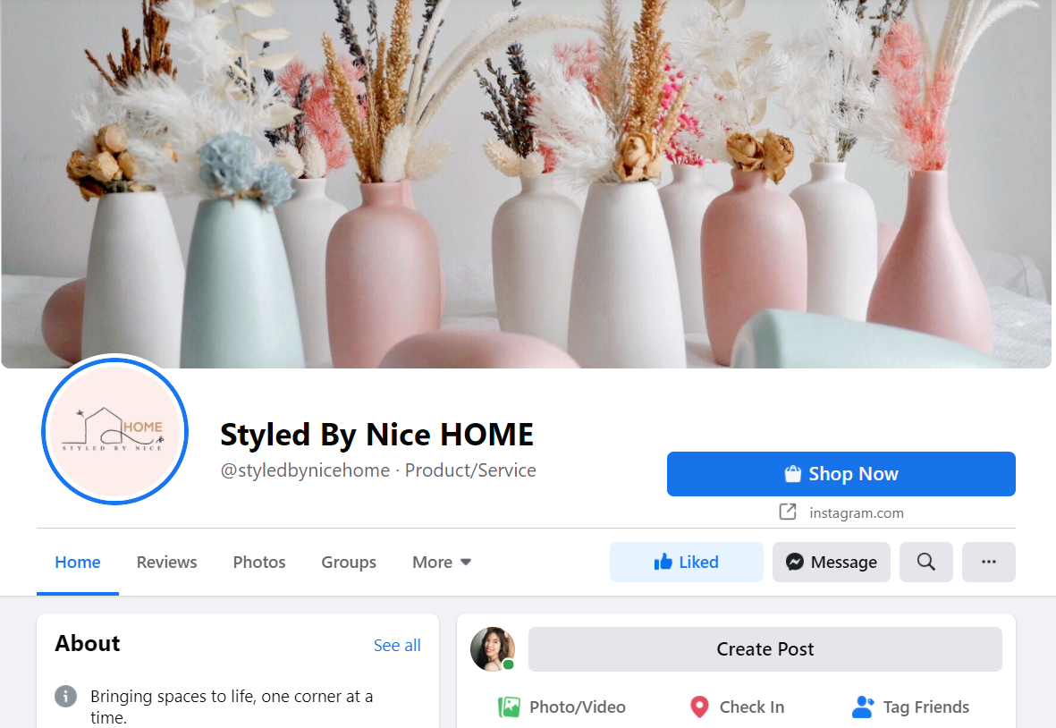
SOURCE OF DATA
The information that would be placed in the website would be coming from the owner, Claire Domanog of StyledByNice HOME and their social media accounts.

Slide 4
Mockup Prototype

Slide 5
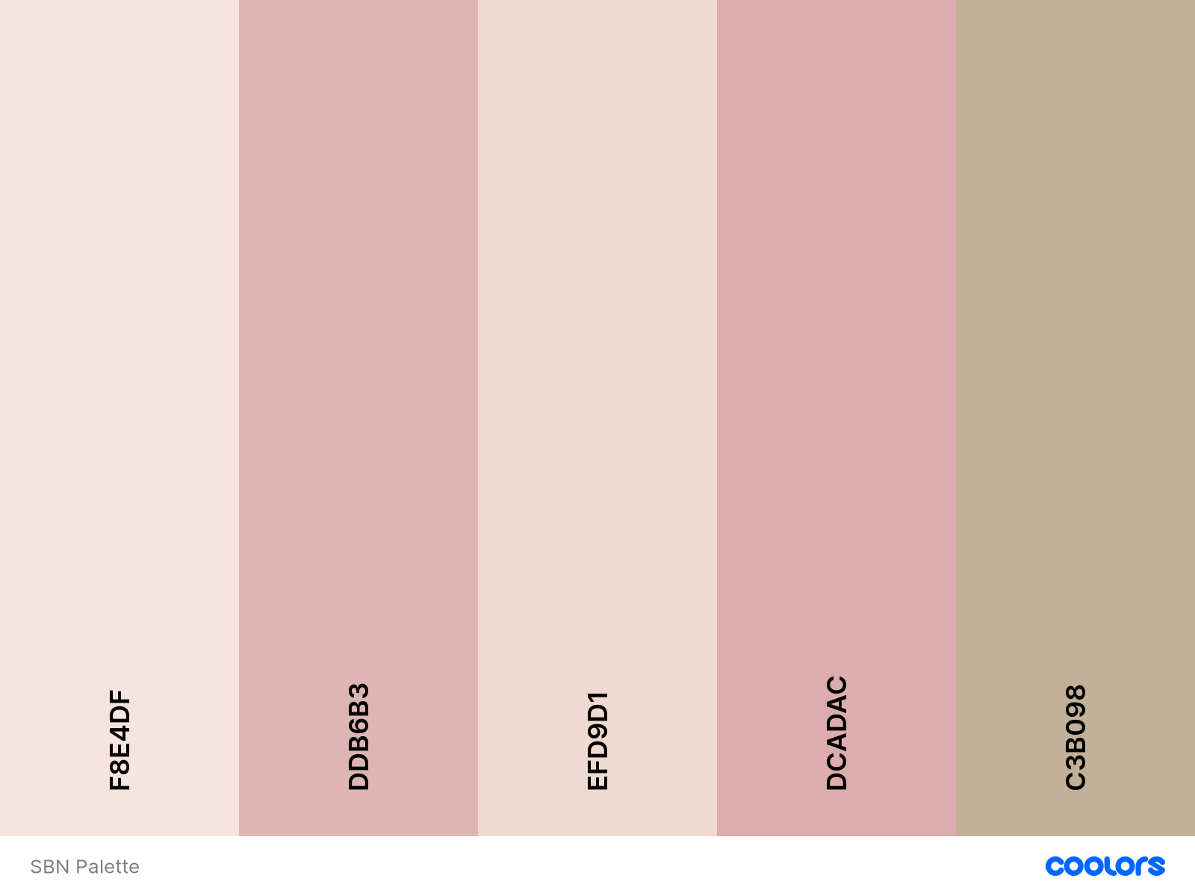
Color Palette

Slide 6

Logo

Slide 7
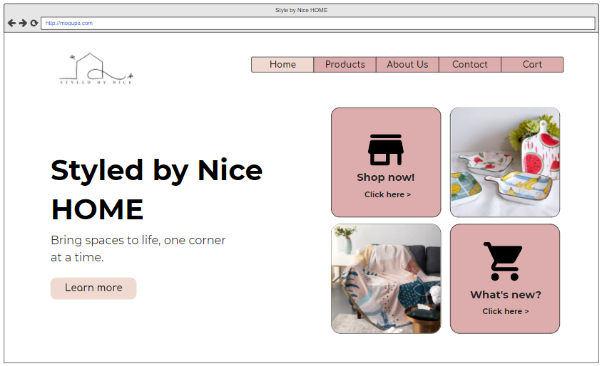
Home

Slide 8
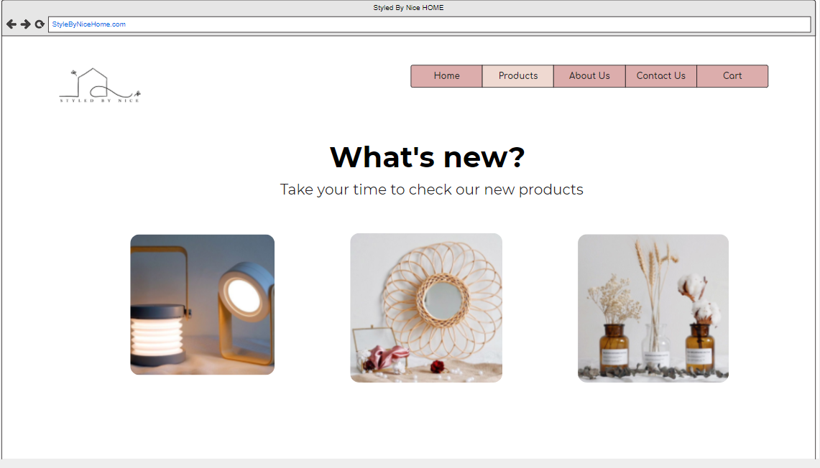
What’s new

Slide 9
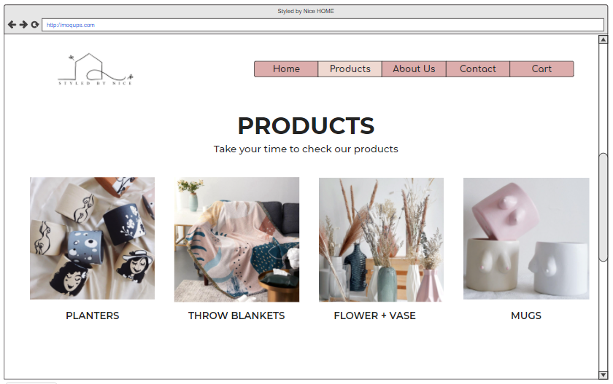
Products

Slide 10
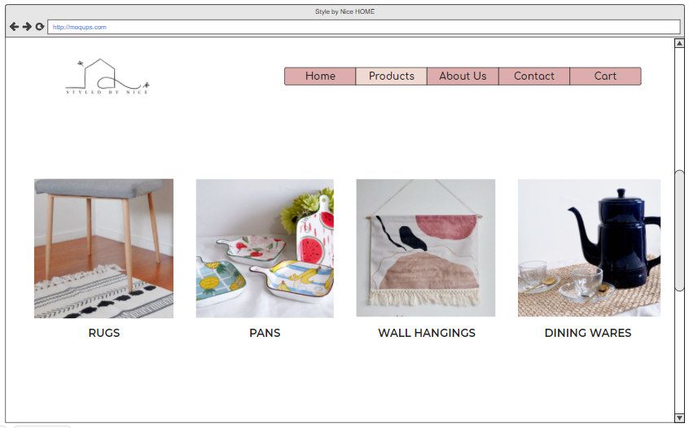
Products

Slide 11
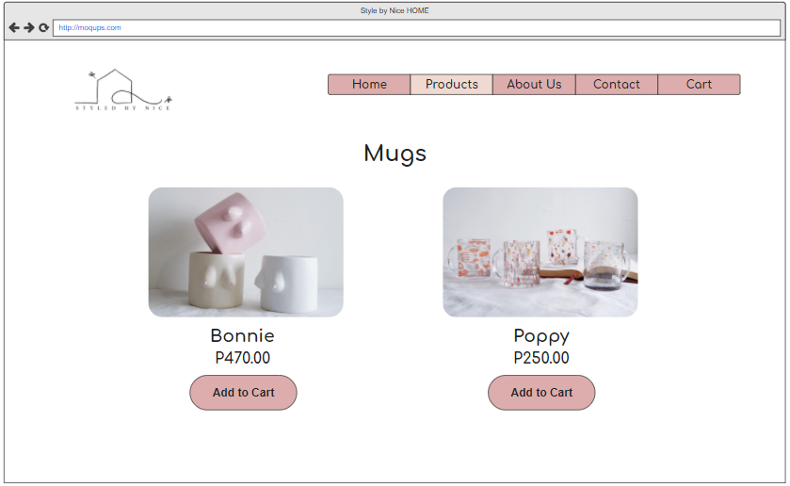

Slide 12
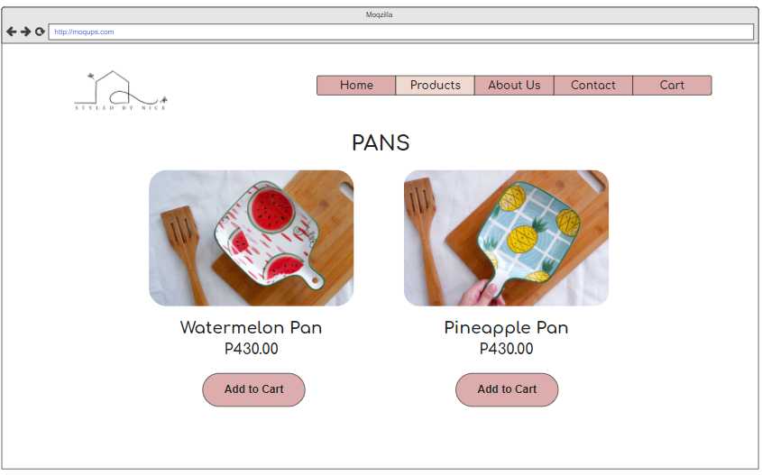

Slide 13
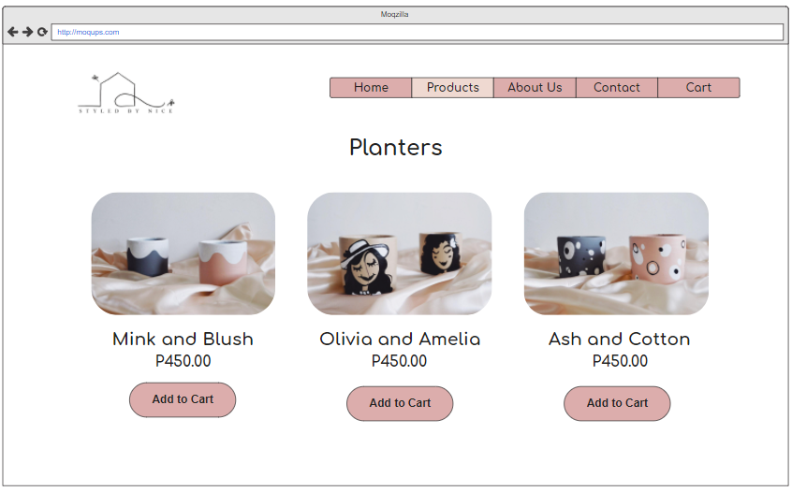

Slide 14
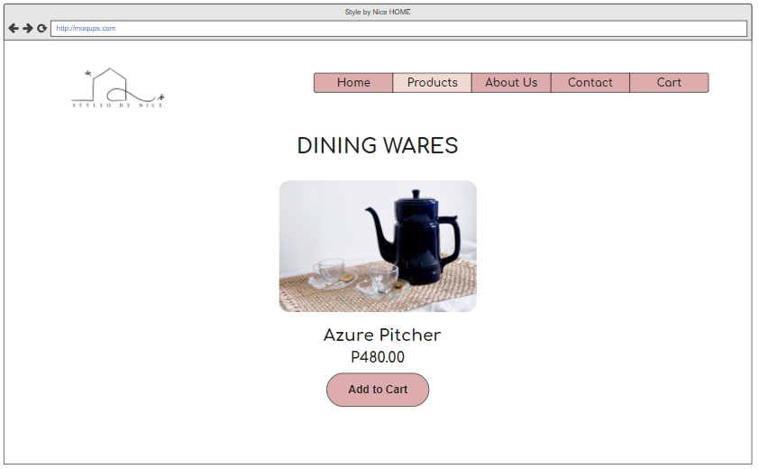

Slide 15
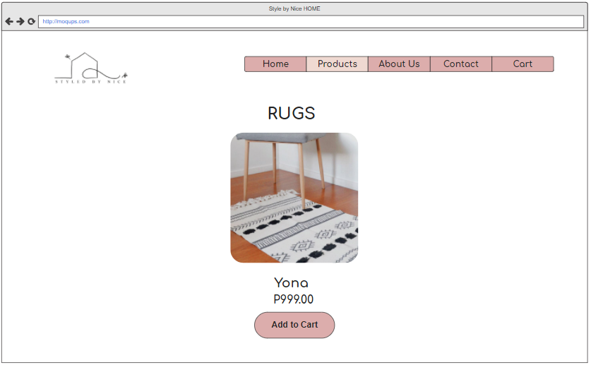

Slide 16
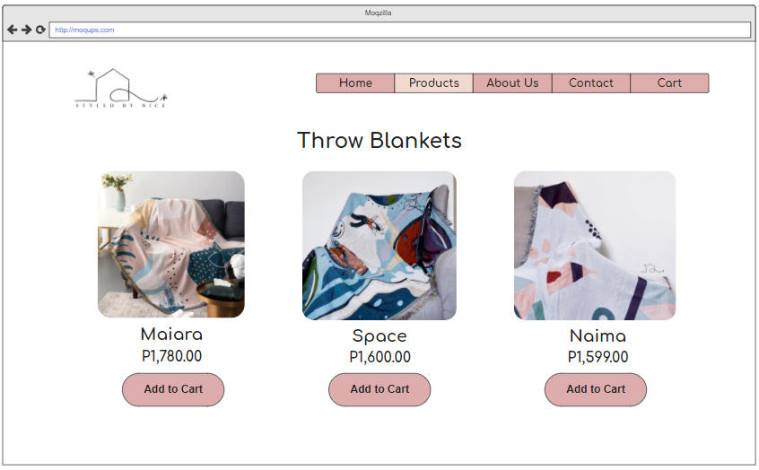

Slide 17
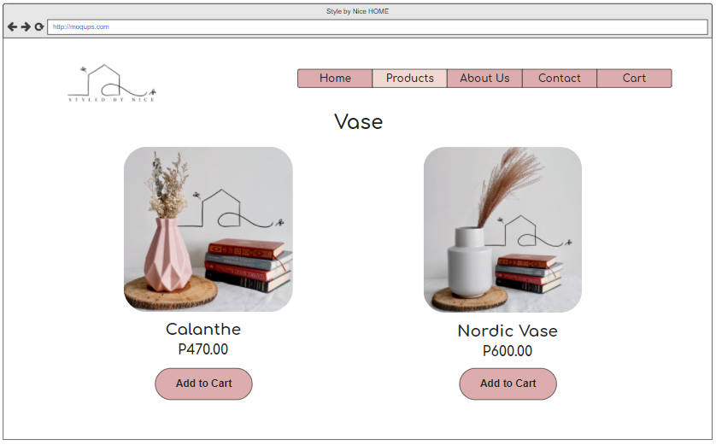

Slide 18
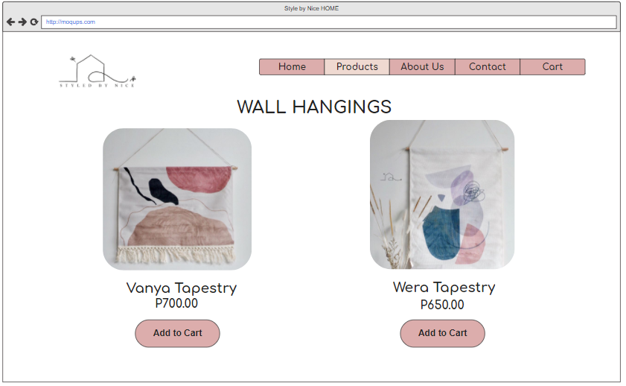

Slide 19
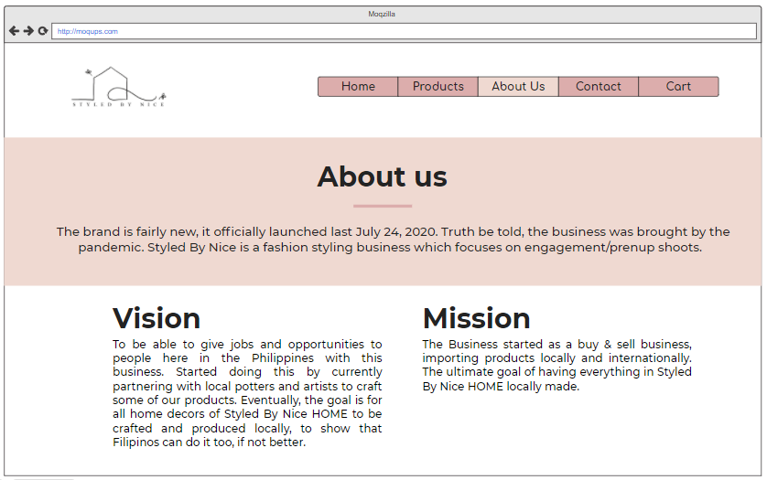
About Us

Slide 20
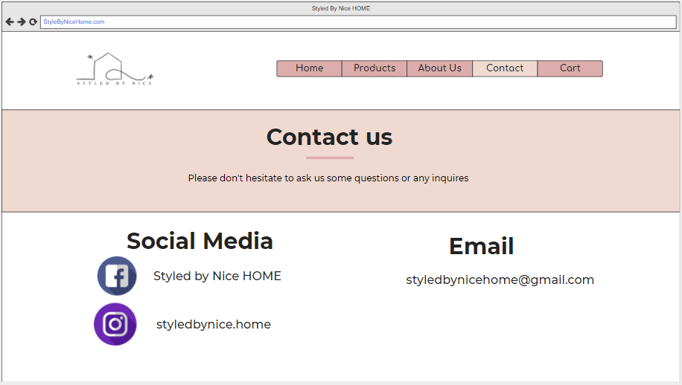
Contact us
Notes:
**********************

Slide 21
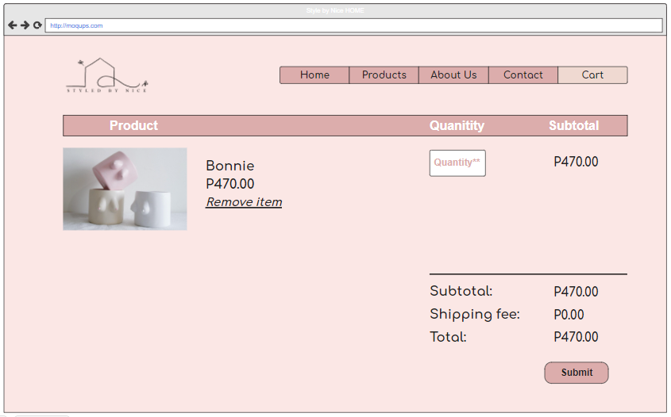
Cart

Slide 22
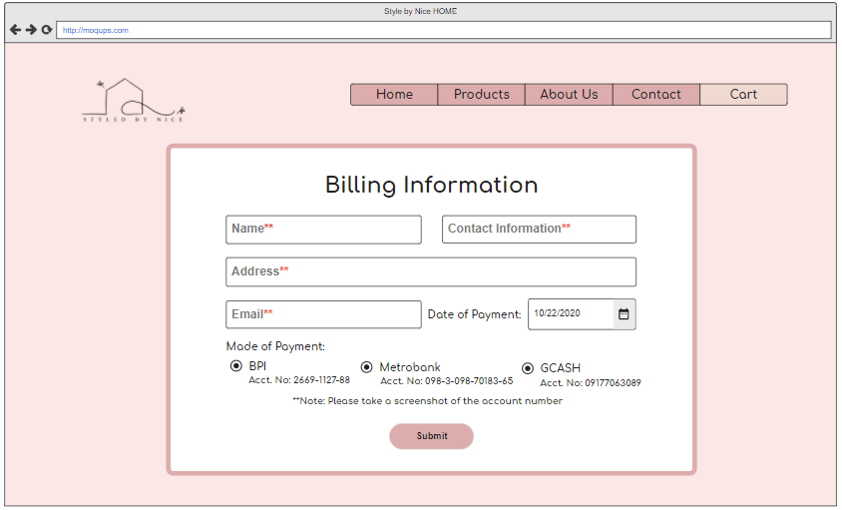
Billing Information
Billing Information

Slide 23
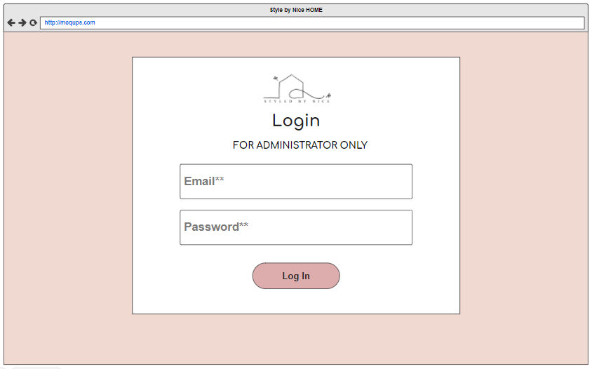
Log in

Slide 24
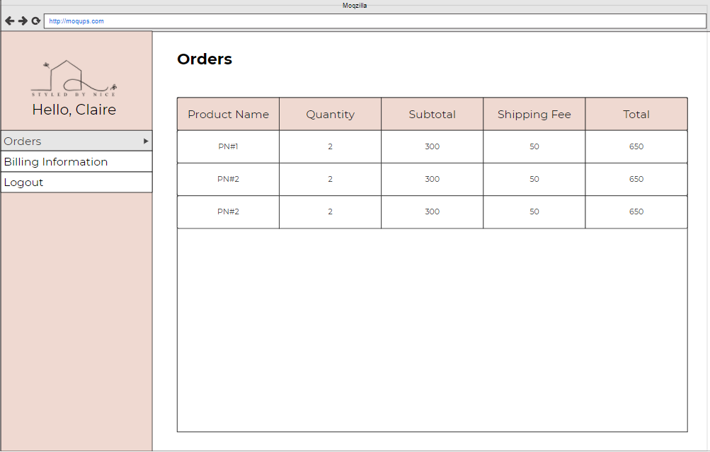
Dashboard

Slide 25
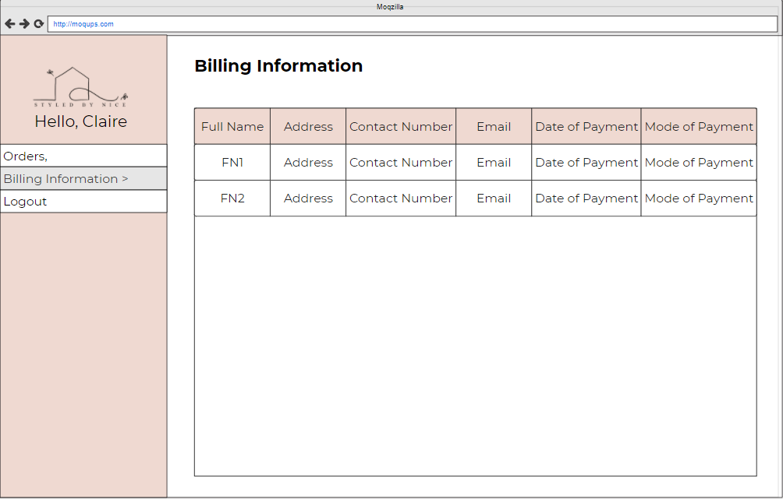
Dashboard

Slide 26

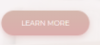
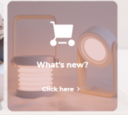
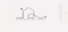
Buttons
Learn More Button
It will go to a page where the company’s mission and vision is written, the history, and other important information
Shop Now
It will go to the products page.
What’s New
It will go to the new page where new items are placed.
Homepage Logo in Menu Bar
It will go to the Login Page

Slide 27
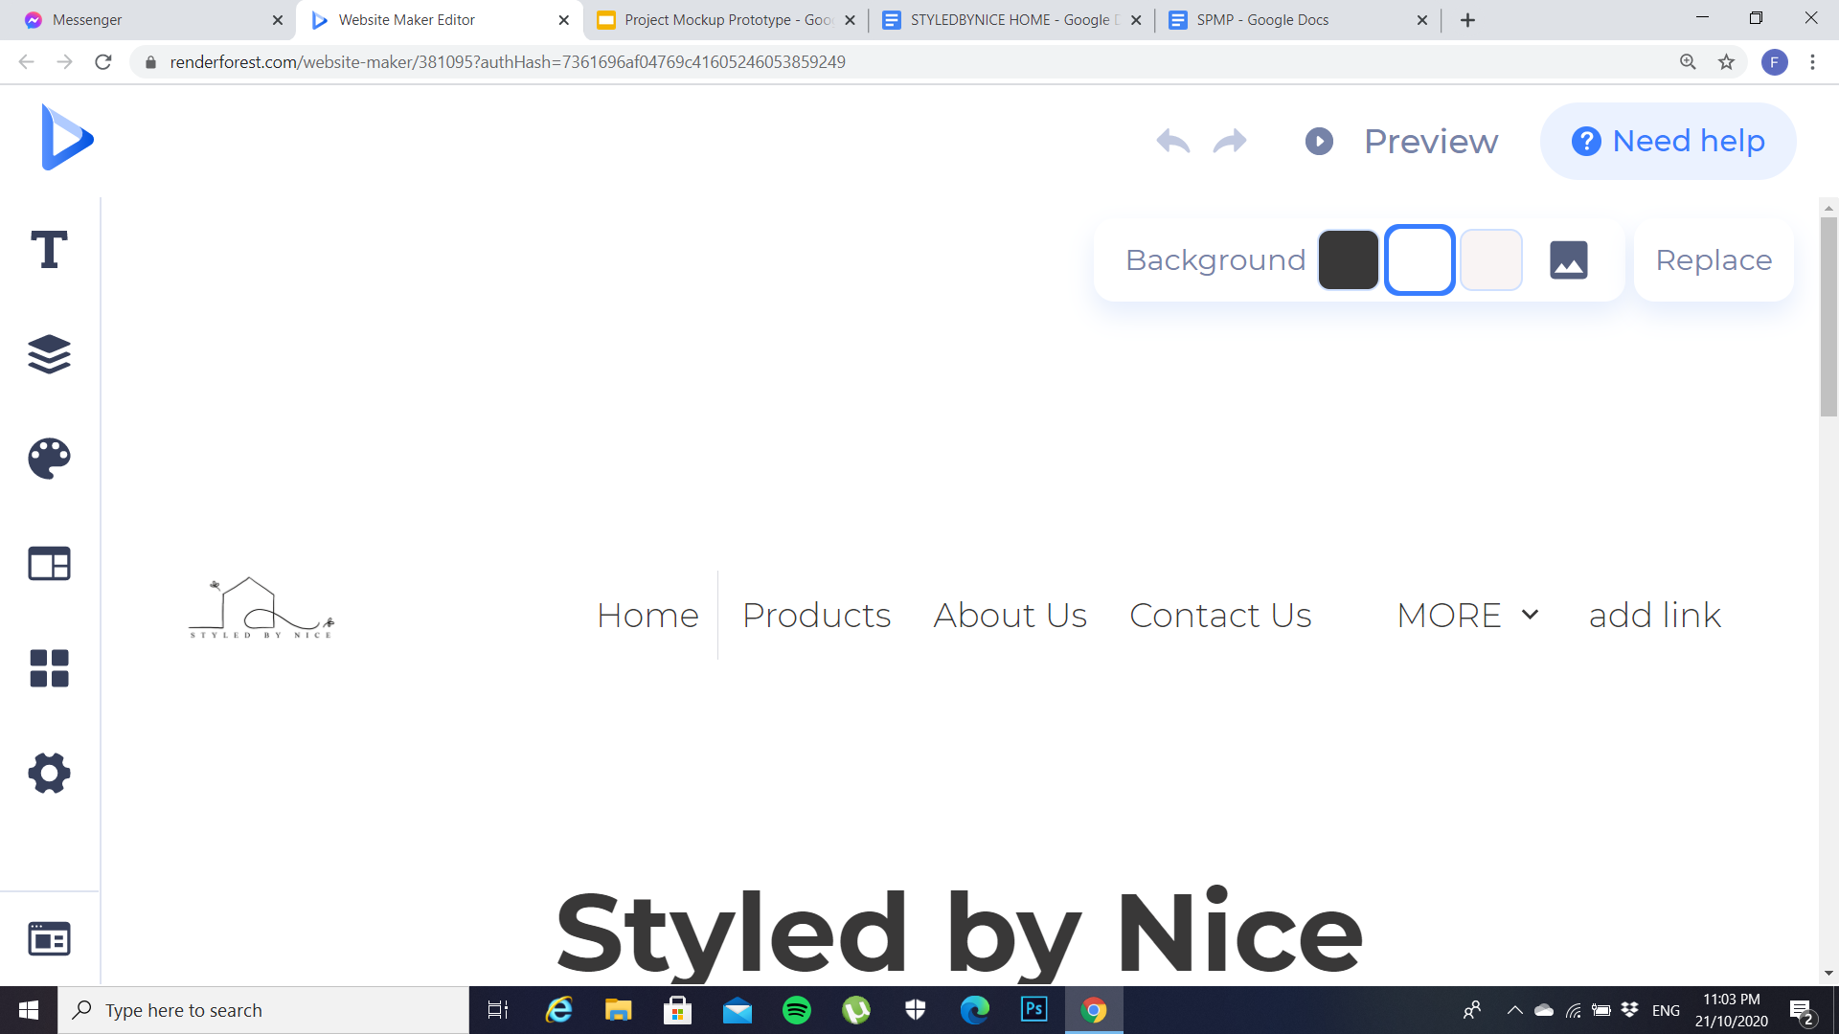
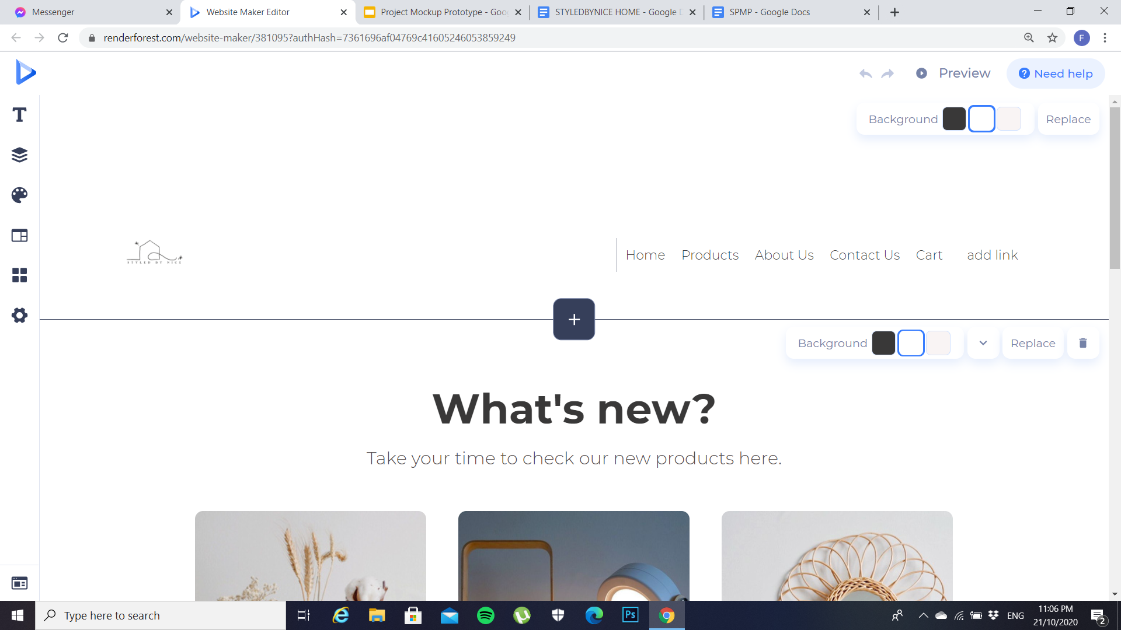
Buttons
Home
It will go to the homepage.
Contact Us
It will display the contact details of StyledByNice HOME
Products
Also includes a dropdown for the category of the products.
Cart
It will display the items in your cart.

Slide 28
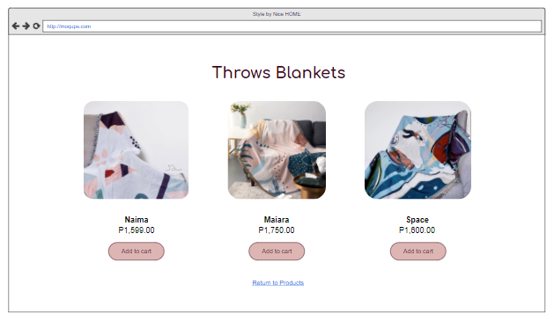
Buttons
Add to Cart
The items you added will be added to the cart.

Slide 29
Thank you.
(End of Presentation)

